Slide 1

FANTASTIC 5
Iteration 0
PORTFOLIO PRESENTATION
1 / 16
14 MAY, 2024

Slide 2
WELCOME
Content
OVERVIEW
RELATED WORK
REQUIREMENTS
MANAGEMENT
Information regarding how we are going to proceed forward with our project
QUALITY ASSURANCE
REFERENCES
2 / 16
14 MAY, 2024

Slide 3
MEET THE TEAM
BRENNA MAHN
NATANIM EIBRAHIM
PINWEN
MU
TEAM LEADER
SECURITY
CONFIGURATION
FEHMI
BALTACI
SAVIEN
LOVE
QA & REQUIREMENT
DESIGN & IMPLEMENTATION
3 / 16

Slide 4

FANTASTIC 5
Overview
Develop a user-friendly and engaging online learning platform to support project-based learningWe aim to provide a better engagement experience for our target users, ensuring seamless interaction with the backend systems
4 / 16

Slide 5
MOTIVATE
PURPOSE
TARGET
FUNCTION
BRIDGE
HUB FOR EDUCATORS
USERS
USER-FRIENDLY
5 / 16

Slide 6

TECHNOLOGY
REACT.JS
SASS
Material UI
Pivitol Tracter
Docker
VSCode
GIT
Formit
Technology
6 / 16

Slide 7
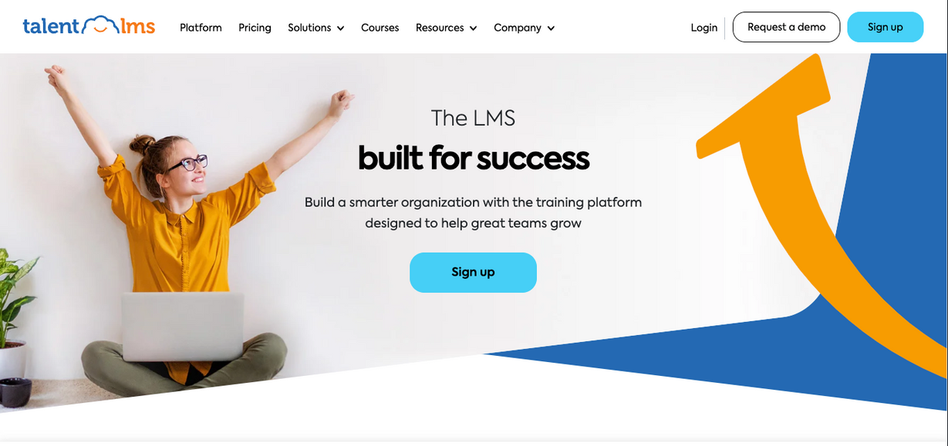
Related Work

Slide 8

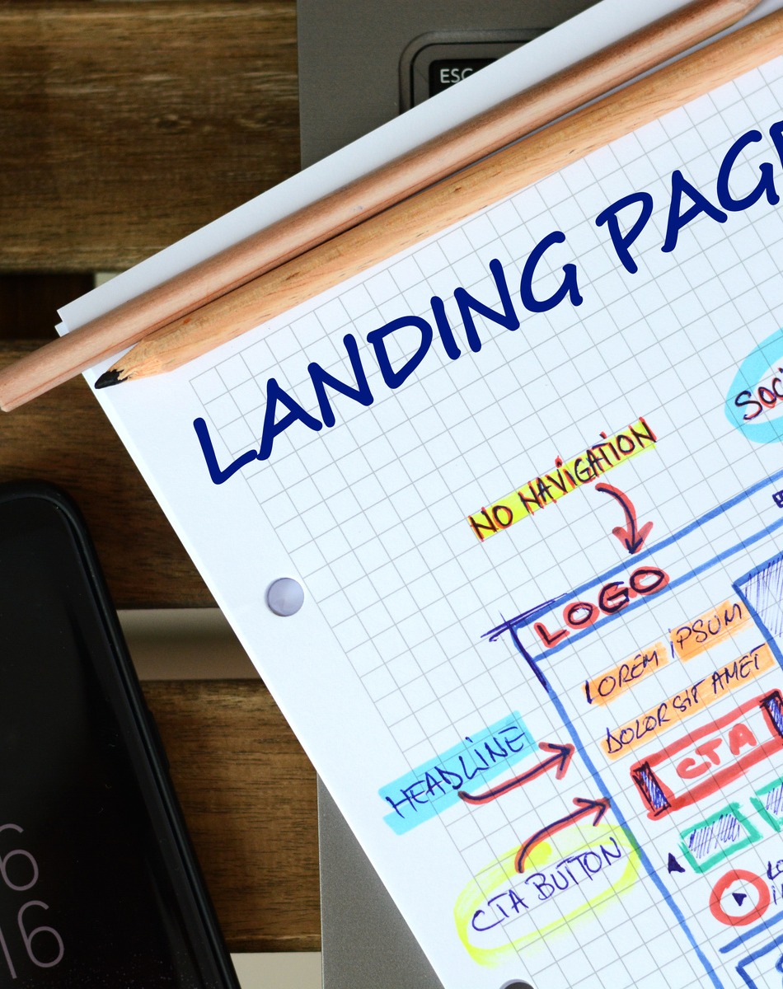
Requirements
Functional Features
Essential
Desirable
Optional
Nonfunctional
7 / 16
19 AUGUST, 2021

Slide 9

MANAGEMENT PLAN
Complete App Proposed Essential Features
Maintain High Quality Thoughout Development Process
Ensure the Software if Free of Known Bugs
Adhere to Security Best Practices
Deploy Successfully
Ensure Scalability & Performance
Foster User Engagement & Satisfaction
14 MAY, 2024

Slide 10

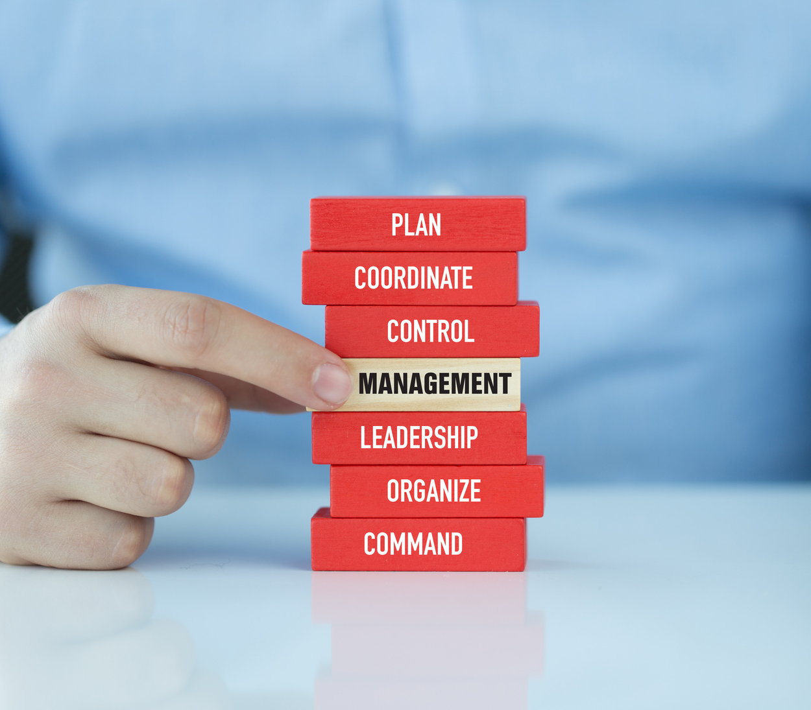
FANTASTIC 5
RISK MANAGEMNENT
Our project team has identified several key risks that could impact the development and deployment of our software. To manage these risks effectively, we have adopted a proactive risk management approach.
14 MAY, 2024

Slide 11

FANTASTIC 5
ITERATION | FUNCTIONAL REQ. | TASKS | ESTIMATED HOURS
1 | User Registration User Login Project Creation Project Editing Task Assignment and Deadline Setting | UI Development, Backend Integration, Testing | 20 15 25 10 15 15
2 | Project Analytics Deadline Notifications Update Notifications Learning Materials | UI Development, Backend Integration, Testing | 20 25 20 25
3 | User Profile Team Roles and Permission Management Project Search | UI Development, Backend Integration, Testing | 20 15 20 25
TIMELINE
11 / 16
14 MAY, 2024

Slide 12

TOOLS:
Version Control
IDE
Frontend Frameworks
Libraries
Package Managers
CI/CD
Containerization
Configuration Management Plan
11 / 16
14 MAY, 2024

Slide 13
FANTASTIC 5
Code Commit Guideline & Git Branching Strategy
CCG
GBS
Branching
Pull Requests
Commits
Environment Coordination
Auomated Deployment
Version Control & Rollack
12 / 16
14 MAY, 2024

Slide 14


FANTASTIC 5
Quality Assurance
Metrics
Defect Rate
Test Coverate
Coding Standard
Industry Standard
Review Process
PR
Peer Review
Testing
Unit Testing
Defect Management
Pivitol Tracker
9 / 16
14 MAY, 2024

Slide 15
FANTASTIC 5
Thank You
Iteration 0
14 MAY, 2024

